Slide 1
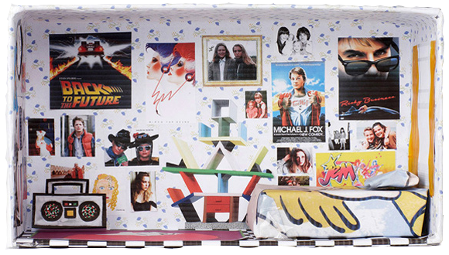
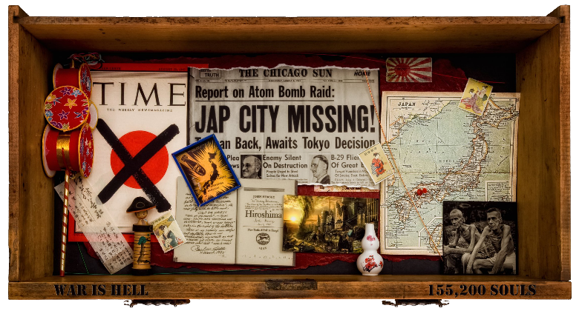
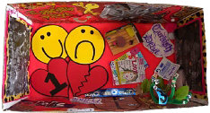
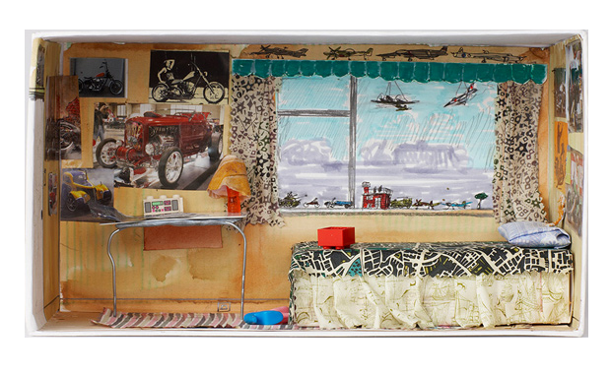
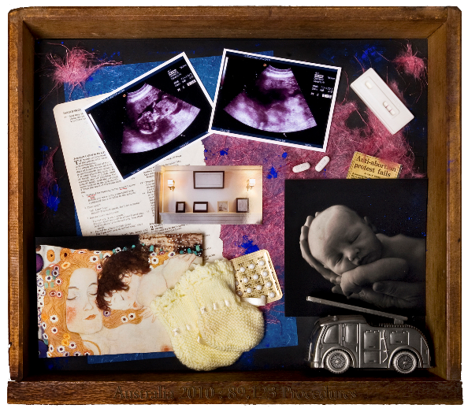
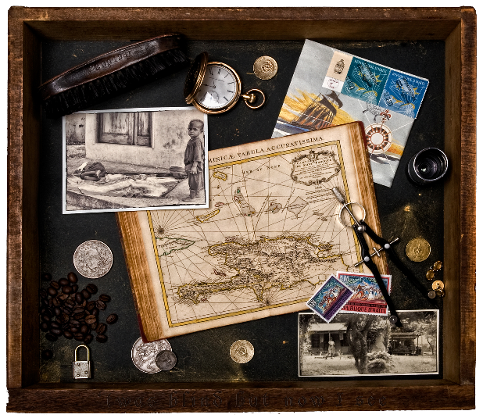
Identity Box Competition
An “identity box” is a box filled with things that represent you. It can include anything as long as they are things that are personal to you. It could be drawings, images of things that you like, photographs or objects. The box can be made from any material as long as it is strong. Examples are shown below:
Rules for the competition:
It must include a drawing.
It must be colourful.
The boxes will be Judged by Mr Lawlor and Mrs Wystawnoha from Falinge Park High School and prizes will be rewarded for Creativity, Presentation and Care.
Definition of “Identity”:
The characteristics determining who or what a person is.

